Slide 1




Social Media Analysis for Situation Awareness during Crises (SMASAC)
GRÉGOIRE BUREL¹, MAYANK KEJRIWAL² AND PRASHANT KHARE¹
¹Knowledge Media Institute, The Open University, Milton Keynes, UK.
²Information Sciences Institute, University of Southern California, Marina del Rey, CA, USA.
WebConf’18, Lyon, France.
23-27 April 2018.
Notes:
Good morning everbody and welcome to this tutorial about social media analysis for situation awareness during crises tutorial…

Slide 2
SMASAC - Introduction
GRÉGOIRE BUREL, MAYANK KEJRIWAL AND PRASHANT KHARE

Slide 3



Organisers
Grégoire Burel
Research associate and data scientist at the Knowledge Media Institute (Open University) involved in the COMRADES European project and the lead developer of the Crisis Event Extraction Service (CREES).
Mayank Kejriwal
Computer scientist in the Information Integration group in the Information Sciences Institute (ISI) at the USC Viterbi School of Engineering and works on knowledge graph construction and information extraction for socially consequential domains.
Prashant Khare
PhD student at the Knowledge Media Institute (Open University). His research focuses on extracting knowledge from crowd-generated content in course of crisis/disaster situations.

Slide 4
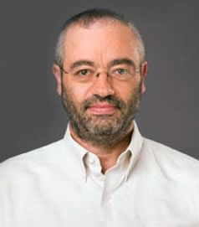
Speakers
Prashant Khare
PhD student at the Knowledge Media Institute (Open University). His research focuses on extracting knowledge from crowd-generated content in course of crisis/disaster situations.
Grégoire Burel
Research Associate
Prashant Khare
Ph.D. Student
Pedro Szekely
Research Associate Professor
Research Associate Professor
Notes:
Each of us introduce themselves…

Slide 5


Tutorial Outline / Repository
Start Time | Duration (min.) | Session Name | Description
9:00am | 20 | Introduction | Introduction to situation awareness and social media use during crises.
9:20am | 30 | Data Collection | Data collection and basic filtering.
9:50am | 30 | Entity Extraction | Presentations of tools and methods for extracting entities.
10:20am | 40 | Coffee Break | Coffee break and technical support.
11:00am | 30 | Categorisation | Automatic classification of documents.
11:30am | 30 | Event Extraction | Tools and methods for event extraction.
12:00pm | 20 | Visualisation | Examples of some situation awareness platforms.
Slides and Code: http://github.com/evhart/smasac-tutorial
Notes:
Lets first talk about the tutorial structure…
We have 6 sessions that will both contain slides and hands-on sessions that are run using notebooks.
All the code and slides are available on the following github repo.

Slide 6
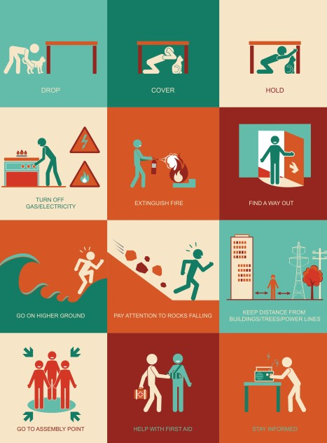
Crisis Situation
A crisis (from the Greek κρίσις - krisis; plural: "crises"; adjectival form: "critical") is any event that is going (or is expected) to lead to an unstable and dangerous situation affecting an individual, group, community, or whole society.
Responding to crises rapidly is critical as they can involve:
Personal injuries (death, trapping, missing, etc.)
Infrastructure damage (roads blocked, services, etc.)
Global issues (civil arrest, conflicts, etc.)
Services overload (availability and access of emergency services and to resources)
How do we better understand a crisis situation in order to act accordingly?
Notes:
What is a crisis situation?
It is an event that may lead to an unstable or dangerous situation.
Responding quickly is important dues to risk of injuries, infrastructure damage and so on.

Slide 7
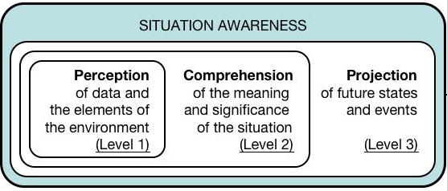
Situation Awareness (1)
Situation awareness is the perception of environmental elements and events with respect to time or space, the comprehension of their meaning, and the projection of their status.
Endsley's model of Situation Awareness (Endsley, 1995)
Information filtering, classification, entity extraction, etc.
Relation extraction, relevance, visualisation, etc.
Prediction models, time series analysis, etc.
Notes:
In this tutorial we are focusing on situation awareness…
In technical terms it means: 1) obtaining information; 2) Extracting meaning and understanding; 3) Predicting future events…

Slide 8
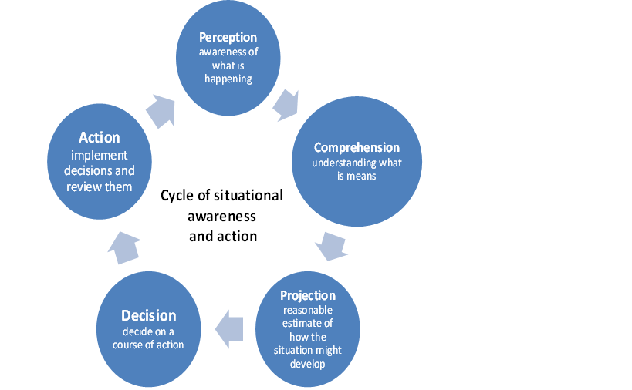
Situation Awareness (2)
Situation awareness is the perception of environmental elements and events with respect to time or space, the comprehension of their meaning, and the projection of their status.
Why do we need situation awareness during crises?
Accessible knowledge can be integrated to assess and cope with a situation (Sarter 1991).
Citizens and responders must be able to collect reliable information and build an understanding of the current situation and its evolution (Endsley, 1995).
Obtain accurate real-time and complete information about a particular crisis situation (Winerman, 2009).
How do we collect and process efficiently information during emergency situations?
Notes:
Why do we need awareness?
Help coping with a situation.
Collect relevant information
Get the big picture

Slide 9

Social Media (1)
Social media consist of web technologies and platforms that enable people to interact and engage by creating content in a conversational and participatory manner
Social web applications are created to encourage communication between people, they tend to have some of the following attributes:
Identity: who are you? (e.g., Facebook)
Reputation: what do people think you stand for? (e.g. LinkedIn)
Presence: where are you? (e.g., Four Square)
Relationships: who are you connected with? who do you trust? (e.g., Facebook)
Groups: how do you organize your connections?
Conversations: what do you discuss with others? (e.g., Reddit).
Sharing: what content do you make available for others to interact with?
Notes:
Lets now talk about social media…
Social media are technologies that enable people to interact and engage online….
They have multiple features such as.. Identity, relationship, conversations, location etc…

Slide 10
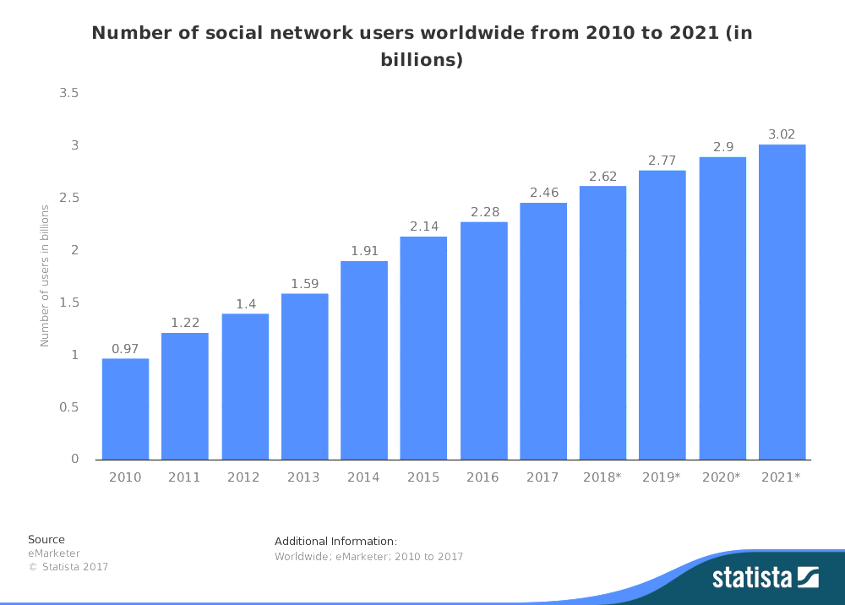

Social Media (2)
Notes:
Social media is ubiquitous more that 1 third of the population use social media.
It is also characterised by the 4 Vs…

Slide 11








Social Media and Crises
Social media has become a common place for communities and organisations to communicate and share information during crises, to enhance their situational awareness, to share requests or offers for help and support, and to coordinate their recovery efforts.
Example of Twitter usage during crises (+200m active users / +400m posts a day):
During the 2011 Japan earthquake, 177 million tweets related to the event were sent in one day.
The news about the Boston bombings first appeared on Twitter.
How do we obtain situation awareness from noisy and large heterogeneous high-velocity real-time unstructured data?
Notes:
During crises social media is used extensively with people offering their help or asking for help using social media when other communication means are not working…
For example…

Slide 12
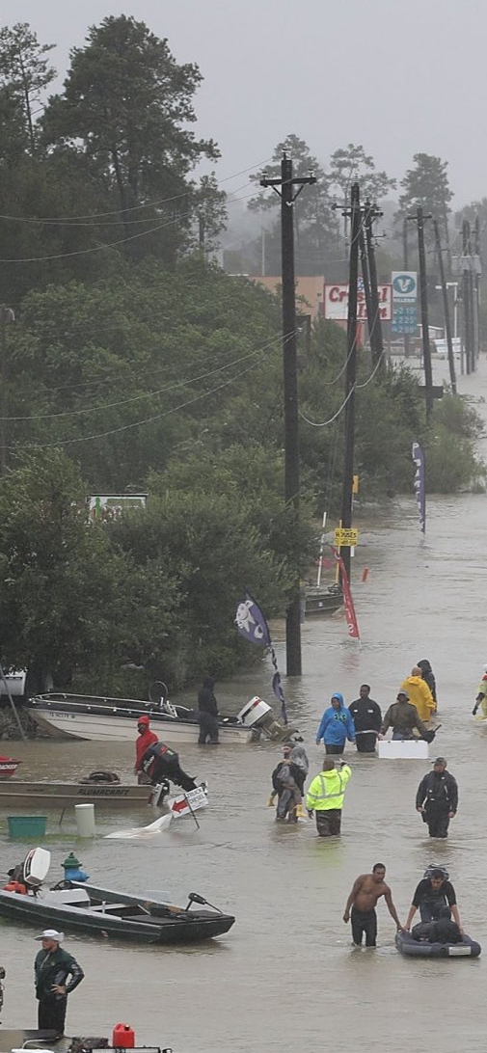
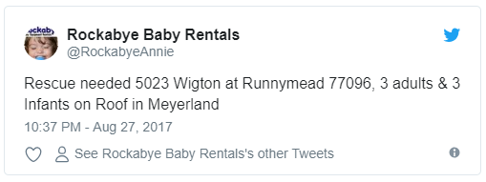
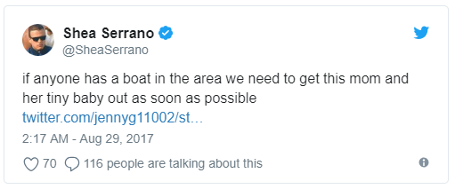
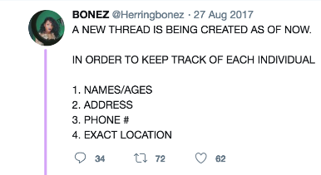
Hurricane Harvey – Twitter Usage (1)
Notes:
For example….
But…

Slide 13

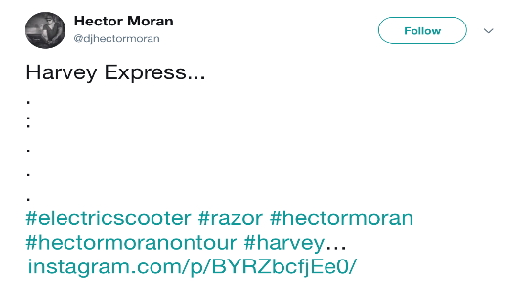
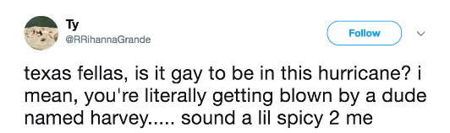
Hurricane Harvey – Twitter Usage (2)
Notes:
There is also irrelevant information that needs to be filtered or classified in order to focus on what is important…
That is the focus of this tutorial…

Slide 14
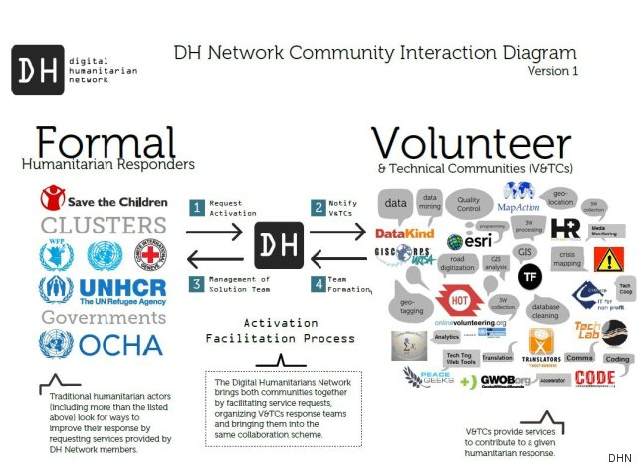
Digital Humanitarian Network et al.
With the emergence of social media and access to other technologies (e.g., mapping tools and information management platforms), digital volunteer networks have been created to help data processing tasks. Nevertheless, low-level tasks (e.g., data collection, information extraction and filtering) remain mostly manual labour.
Notes:
There is already volunteers organisations and individuals that help NGOs…

Slide 15

Digital Situation Awareness Pipeline
When dealing with information collected from various online sources (e.g., SM, mapping software, etc.), it is necessary to be able to collect, represent, process and visualise such information in order to better understand a situation.
Collect
Analyse
Understand & Visualise
Act
Gather data from various information sources
Extract key information, verify trustworthiness, classify, etc.
Connect and Visualise information.
Decide what to do and organise actors and resources.
Notes:
Typically they work in this fashion…
For instance OCHA or another NGO activate them so that volunteer gather/process and release information that is then acted upon by the NGOs.

Slide 16
Typical (Manual) Processing Pipeline
During crises, most of the data is processed manually by crisis responders, digital humanitarian, organisations and individuals.
Collect
Search/browse social media website. Copy/paste in spreadsheet.
Analyse
Curation and Filtering
Classification
Entity Extraction
Manually select relevant posts during collection.
Annotate data / information priority, etc.
Understand & Visualise
Visualisation
Use visualisation applications (e.g., Ushahidi, OSM) or libraries.
Notes:
Unfortunately this remains a mostly manual task…

Slide 17
Automatic Processing Pipeline
Supervised or semi-supervised methods as well as APIs an automatic tools can be used for collecting data.
Collect
Use API for collecting data.
Analyse
Curation and Filtering
Classification
Entity Extraction
Use event detection models for filtering documents.
Supervised / non-supervised classification models.
Named Entity Recognition and Entity Linking.
Understand & Visualise
Visualisation
Use visualisation applications (e.g., Ushahidi, OSM) or libraries.
Notes:
This changes when using automated methods…

Slide 18
Automatic Data Collection and Analysis
Collect
Data can be easily collected without requiring manual browsing:
Use streaming/search API for collecting data.
Typically restrict search using keywords and location.
Reformat data/extract basic information automatically for further processing (e.g., tokenisation, hashtags, URLs).
Store data in database (or save in a file).
Analyse
Curation and Filtering
Classification
Entity Extraction
Relevant data can be filtered automatically using keywords as well as event classifiers:
Use trained classifiers for identifying relevant documents and other relevant information.
Dynamically re-train classifiers.
Extract important information from documents (e.g., locations, actors, etc.):
Use Named Entity Recognition (NER) tools.

Slide 19
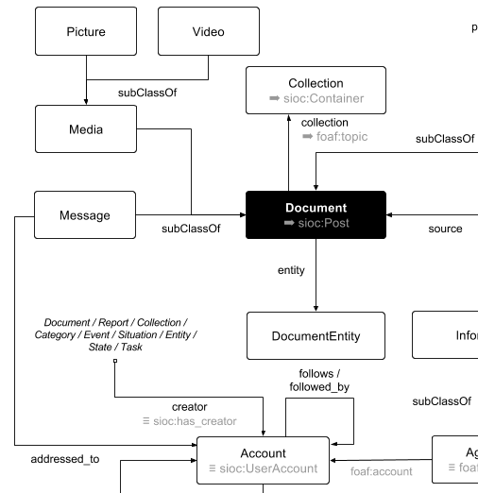


Data Visualisation
Understand & Visualise
Visualisation
Visualisation platforms or libraries can be used for visualising the processed data. For example, the following visualisation can be done:
Import data in situation awareness platforms (e.g., Ushahidi, Sahana).
Directly visualise the data using visualisation libraries (e.g., D3, Plotly, Bokeh, etc.)
Use HDX headers and Quick charts.
Use ontological visualisation platforms (e.g., Topica/WeKnowIt) (Ireson et al., 2010, Cano et al., 2011).
Typically, the first step before visualisation would be to export the data in a common model or reformat the data according to the target platform:
CSV or CSV with HDX headers (HXL).
JSON format or custom format
Common ontology (e.g., CURIO, DoRES, etc.) (Burel et al., 2017)

Slide 20




Hands-on Requirements
Notes:
For the hands on….

Slide 21




Software Requirements
Local installation
Local installation
(via Docker image)
Remote execution
(via mybinder.org)

Slide 22













Examples of Tools and Libraries
Collect
Analyse
Understand & Visualise
TwitterNER

Slide 23

Used Data
The tutorial is focusing on Twitter data due the its availability. We use the CrisisLexT26 data since it is already made available. CrisisLex (http://crisislex.org/) is a repository of crisis-related social media data and tools. It includes collections of mostly Twitter crisis data and a lexicon of crisis terms.
The CrisisLexT26 dataset contains:
Tweets from 26 crises, labelled by informativeness, information type and source.
Data collected between 2012-2013.
~250K tweets (~28 000 annotated tweets).
Crises includes: Bombing, Building collapse, Crash, Derailment, Earthquake, Explosion, Fire, Floods, Haze, Shootings, Typhoon, Wildfire…
We also use a dataset about the Las Vegas Massacre :
~50K tweets collected from the Twitter API in the aftermath of the Las Vegas massacre (2017).

Slide 24
Tools/Workspace Configuration
Hands-on
or
Slides and Code: http://github.com/evhart/smasac-tutorial
Notes:
Stop here briefly for questions or small pause before moving on to the next substantive section

